Slide 1
Reaction Tester
Mission 10

Slide 2

Pre-Mission Preparation
In this mission you will use a computer clock to measure time.
What are some things you use a timer for?

Slide 3
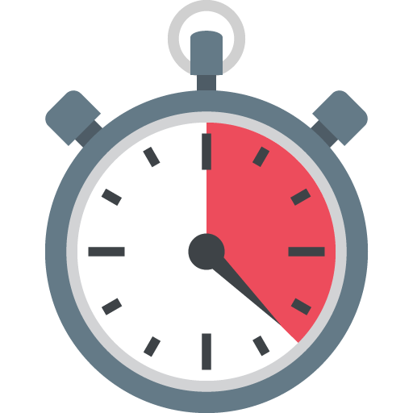
Mission 10: Reaction Time
How fast is your reaction time?
In this project you will make a device to measure your reaction time. This project will:
Give a 3-2-1 countdown
Wait a random delay
Turn the pixels GREEN
Measure the reaction time for the button press
Loop and do the countdown again

Slide 4
Objective #1: Milliseconds
This mission will require you to turn on all the pixels the same color.
The code so far turned on a single pixel at a time:
  pixels.set(0, RED)
Using a list, there is an easier way:
  pixels.set([RED, RED, RED, RED])
  Do you notice the list with four items?
  The pixels.set() command needs parenthesis, and the list needs [ ]
  Make sure you use both, in the correct order

Slide 5

Objective #1: Milliseconds
CodeX’s powerful clock can work in milliseconds -- that’s 1,000 times per second!
The clock measures milliseconds, but sleep() is in seconds, so you just have to do a little math.

Slide 6
Objective #1: Milliseconds
random.randrange(1, 5) gives a random number between 1 and 4
random.randrange(1000, 5000) gives a random number between 1000 and 4999.
This gives you a good range of milliseconds, but sleep() uses seconds
1000 milliseconds = 1 second, so
Divide the random number by 1000!

Slide 7
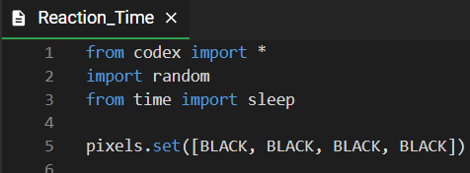
Mission Activity #1
DO THIS:
Start a new file named
Reaction_Time
Import the codex module
Import the random module
Import the time module
Turn all pixels BLACK
<continued>

Slide 8
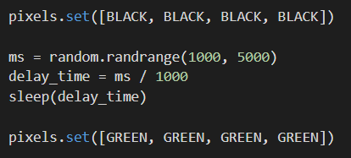
Mission Activity #1
DO THIS:
Get a random number using 1000 and 5000 as the range
Divide the random number by 1000
Use the random number in sleep()
Turn all pixels GREEN

Slide 9

Objective #2: The Countdown
To make this into a game, you want to give a countdown.
This will let the player know the game is starting.
It also indicates when to start the timer.

Slide 10
Objective #2: The Countdown
Use display.clear() to clear the display
Use display.print() to countdown from 3 to 2 to 1 (with a sleep delay in between)
You can scale the number bigger on the display for easy viewing
  display.print(“3”, scale=6)
  sleep(1)

Slide 11
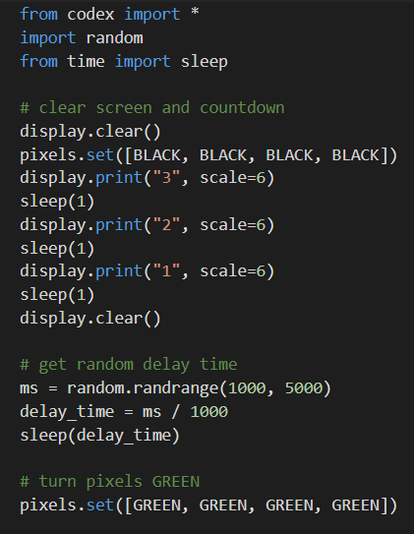
Mission Activity #2
DO THIS:
Clear the display & the pixels
  Set all pixels to BLACK
Countdown from 3 to 2 to 1
Clear the screen again
Then continue the rest of your code to get a random number and light all pixels GREEN

Slide 12

Objective #3: The Fourth Dimension
Computers relay on electronic clock circuits
Clock circuits are used to move through code
They are used as time delays in the sleep() command
When you turn on CodeX, its clock is continuously running.
So far you have used the time module for sleep()
The time module also has a function that returns the current time on the computer clock

Slide 13
Objective #3: The Fourth Dimension
If you want to use more than one function from a module, you need to import the entire library, not just one function
from time import sleep
This imports only one function
import time
This imports the entire library

Slide 14
Objective #3: The Fourth Dimension
When you import the entire library, you must reference it when calling one of its functions.
time.sleep(1)
time.ticks_ms()
This returns the current time
It returns a value, so the value needs to be assigned to a variable
start_time = time.ticks_ms()

Slide 15
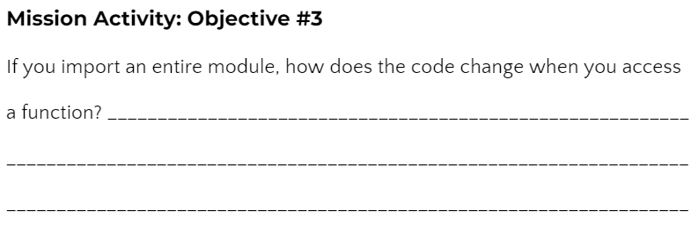
Mission Activity #3
DO THIS:
Go to your Mission Log and answer the question about importing a module

Slide 16
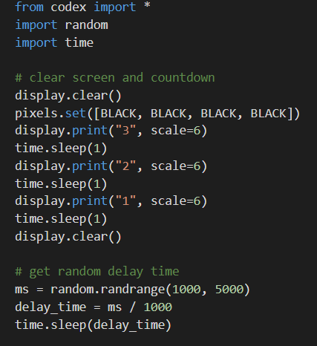
Mission Activity #3
DO THIS:
Change from
time import sleep to
import time
Change all the sleep(1) commands to time.sleep(1) commands
  HINT: There are four sleep() commands
<continued>

Slide 17
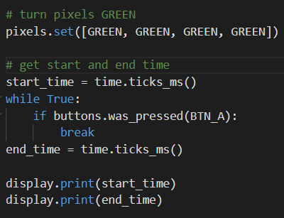
Mission Activity #3
DO THIS:
After the pixels turn GREEN:
Assign start_time the value from time.ticks_ms()
Wait until BTN-A was pressed
Assign end_time the value from time.ticks_ms()
Print start_time and end_time

Slide 18
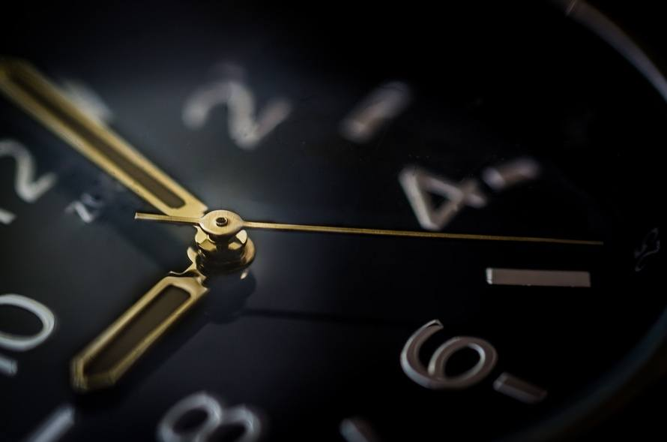
Objective #4: Time Differential
You have the start_time and end_time.
The reaction time is the difference of
the two variables.
You can just subtract the two:
  reaction_time = end_time - start_time
OR use another time module function that finds the difference:
  reaction_time = time.ticks_diff(end_time, start_time)

Slide 19
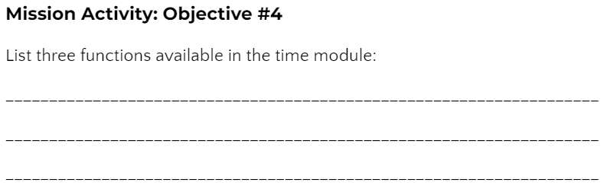
Mission Activity #4
DO THIS:
Go to your Mission Log and answer the question about functions in the time module

Slide 20
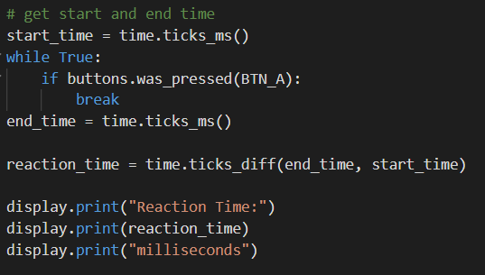
Mission Activity #4
DO THIS:
Assign reaction_time the difference between end_time and start_time
Change the display.print() statements to print the reaction_time instead of start_time and end_time

Slide 21
Objective #5: Let’s Keep Playing
Great job so far! The reaction game is fun, but what if you want to play more than once?
Make the game wait for a button press, and then play again
You will need an infinite loop with most of the code in it
You will need to wait for a button press after displaying the reaction time
You already have code for waiting for a button press, so you can copy and paste it

Slide 22
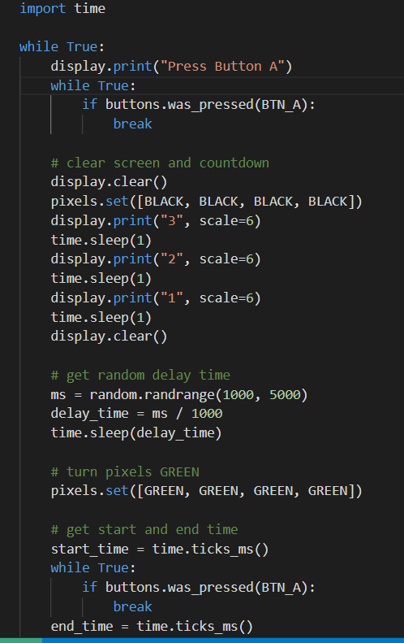
Mission Activity #5
DO THIS:
Add an infinite loop after the import statements
Indent all the code inside the loop
Add another wait loop at the beginning of the loop

Slide 23

Objective #6: Reduce Repetition
Take a look at your code. Do you notice a block of code that is repeated?
You learned in Mission 9 that you can write a function instead of copy-paste or repeating code, you can write a function instead.
There are two places in your code that wait for BTN-A to be pressed

Slide 24
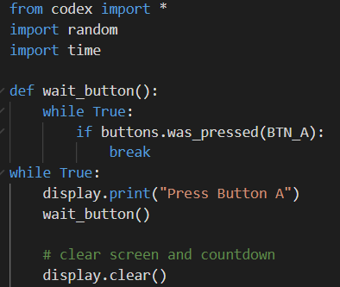
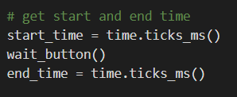
Mission Activity #6
DO THIS:
Write a wait_button() function.
  HINT: A function goes near the top of your code
Delete the code that waits inside the while loop.
Call the wait_button() function two times in the while loop.

Slide 25

Quiz Timing
During this mission you have learned about CodeX’s electronic clock.
Answer 3 quiz questions about the computer timing.
CODEX
QUIZ

Slide 26
Objective #7: No Cheating
Fix a bug. Oh no! Players are pressing the button during the delay and getting ultra fast times.
The buttons.was_pressed() is always listening
Even during the random delay
Solve this problem by resetting the buttons.was_pressed() just before starting the timer

Slide 27

Mission Activity #7
DO THIS:
Reset buttons.was_pressed(BTN_A) just before the pixels turn GREEN

Slide 28
Post-Mission Reflection
Read the “completed mission” message and click to complete the mission
Complete the Mission 10 Log

Slide 29
Clearing your CodeX
Go to FILE -- BROWSE FILES
Select the “Clear” file and open it
Run the program to clear the CodeX

